Slide 1
Software Engineering
Prepared by: Neha Tripathi

Slide 2
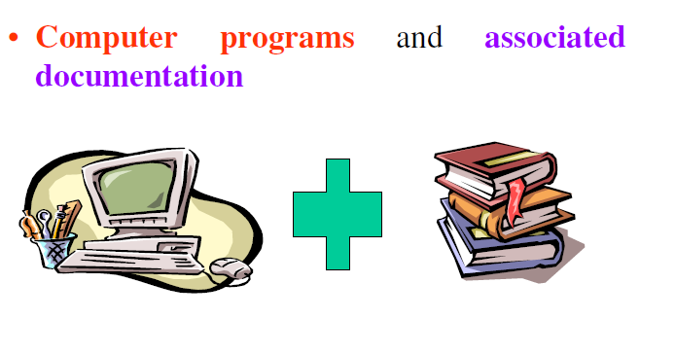
What is software?

Slide 3
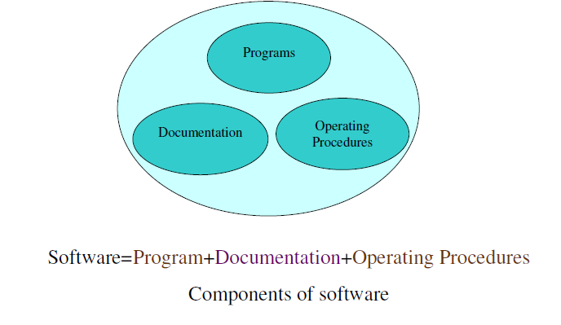
What is software?

Slide 4
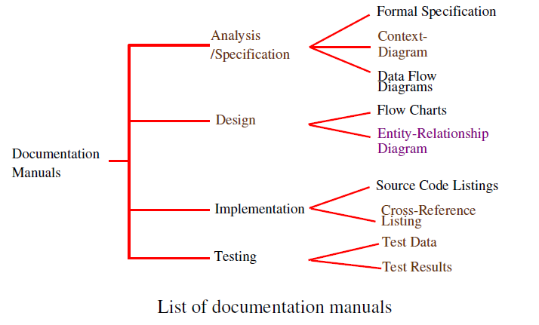
Documentation consists of different types of manuals are

Slide 5
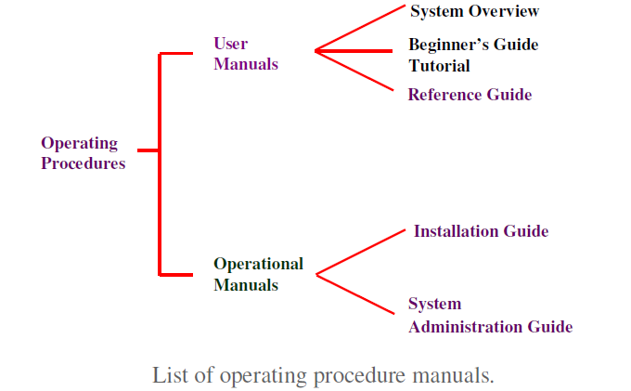
Documentation consists of different types of manuals are

Slide 6
What is software engineering?
Software engineering is an engineering discipline which is concerned with all aspects of software production
Software engineers should
– adopt a systematic and organized approach to their work
– use appropriate tools and techniques depending on
• the problem to be solved,
• the development constraints and
– use the resources available

Slide 7
What is software engineering?
The establishment and use of sound engineering principles in order to obtain economically developed software that is reliable and works efficiently on real machines.
“A discipline whose aim is the production of quality software, software that is delivered on time, within budget, and that satisfies its requirements”.
Both the definitions are popular and acceptable to majority.
However, due to increase in cost of maintaining software, objective
is now shifting to produce quality software that is maintainable,
delivered on time, within budget, and also satisfies its requirements.

Slide 8
Characteristics/Attributes/Features of Software
Its characteristics that make it different from other things human being build. Features of such logical system:
• Software is developed or engineered, it is not manufactured in the classical sense which has quality problem.
• Software doesn't "wear out.” but it deteriorates (due to change). Hardware has bathtub curve of failure rate ( high failure rate in the beginning, then drop to steady state, then cumulative effects of dust, vibration, abuse occurs).
• Although the industry is moving toward component-based construction (e.g. standard screws and off-the-shelf integrated circuits), most software continues to be custom-built. Modern reusable components encapsulate data and processing into software parts to be reused by different programs. E.g. graphical user interface, window, pull-down menus in library etc.

Slide 9
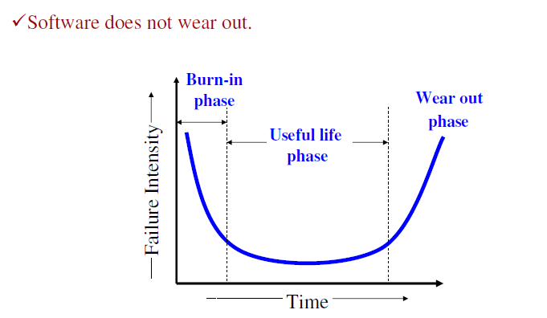
Software Characteristics:

Slide 10
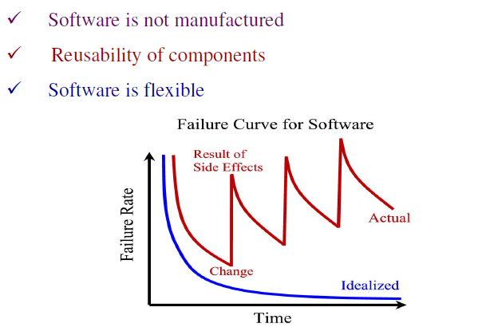
Software Characteristics:

Slide 11
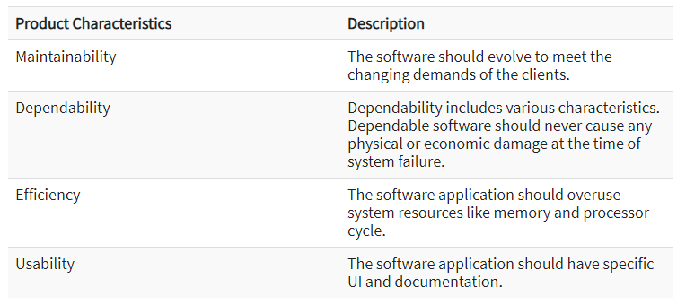
Essential Attributes for Software Products

Slide 12
Characteristics of Good Software
Any software should be judged by what it offers and what are the methods which help you to use it.
Every software must satisfy the following attributes:
-Operational
-Transitional
-Maintenance

Slide 13
Operational
This characteristic let us know about how well software works in the operations which can be measured on:
Budget
Efficiency
Usability
Dependability
Correctness
Functionality
Safety
Security

Slide 14
Transitional
This is an essential aspect when the software is moved from one platform to another:
Interoperability
Reusability
Portability
Adaptability

Slide 15
Maintenance
This aspect talks about how well software has the capabilities to adapt itself in the quickly changing environment:
Flexibility
Maintainability
Modularity
Scalability

Slide 16
Thank you!

